Slide 1

Dental Pain Relief Treatments Effects Study
Checking Assumptions for Randomized Block Model
Xinyi Zhang STA4211 Project 3

Slide 2
Background
Two Medicines: Acupuncture and Codeine
Study the effects of acupuncture and codeine on postoperative dental pain
Four Treatments
A1B1 – placebo treatment (a sugar capsule and two inactive acupuncture points)
A2B1 – codeine treatment (a codeine capsule and two inactive acupuncture points)
A1B2 – acupuncture treatment (a sugar capsule and two active acupuncture points)
A2B2 – codeine and acupuncture treatment (a codeine capsule and two active acupuncture points)

Slide 3
Randomized Block Design
32 Male Subjects
Grouped to 8 Blocks based on initial evaluation on pain tolerance
Randomly apply four treatments to each block
Record pain relief score – Y
Higher Y – more effective
Why Using Blocking?
Lower pain tolerance ---> more sensitive to pain
Higher pain tolerance ---> less sensitive to pain
Balance Confounding Variables
Reduce Experimental Error

Slide 4
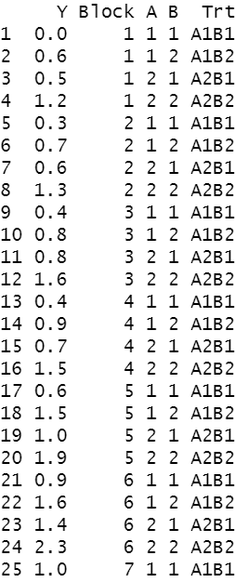
Data Preparation
Set up Factors
Treatment (A1B1, A1B2, A2B1, A2B2)
Block (1 - 8)
Total Subjects = 4 * 8 = 32

Slide 5
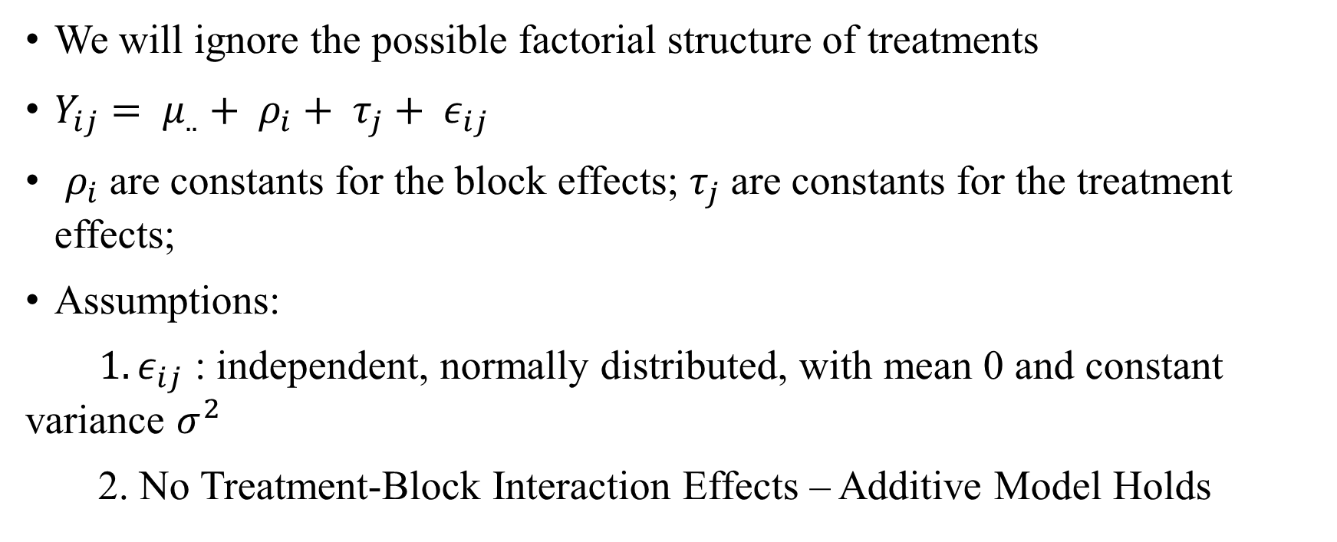
Model and Assumptions
We will ignore the possible factorial structure of treatments
$Y_{ij}= μ_{..}+ ρ_{i}+ τ_{j}+ ε_{ij}$
$ρ_{i}$are constants for the block effects; $τ_{j}$are constants for the treatment effects;
Assumptions:
${ 1. ε}_{ij}$ : independent, normally distributed, with mean 0 and constant variance $σ^{2}$
2. No Treatment-Block Interaction Effects – Additive Model Holds

Slide 6
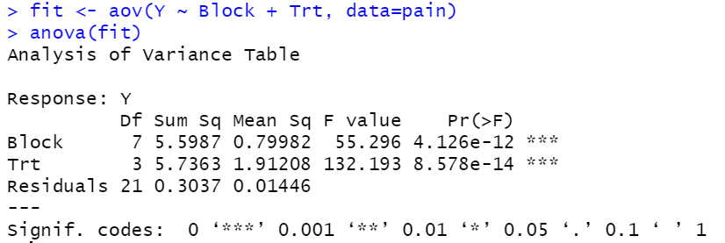

ANOVA Table
Fit our data to the two-way ANOVA using
$Y_{ij}= μ_{..}+ ρ_{i}+ τ_{j}+ ε_{ij}$
Assumptions Satisfied?

Slide 7
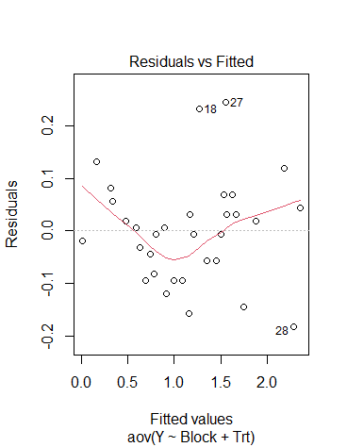

Check Error Assumptions
$ε_{ij}$ : independent, normally distributed, with mean 0 and constant variance $σ^{2}$
The relationship between residuals and fitted values seem to have a quadratic appearance
Do not have constant variances at each fitted value
Additive Model?
Additivity test is needed

Slide 8
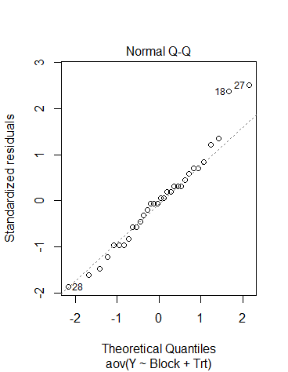
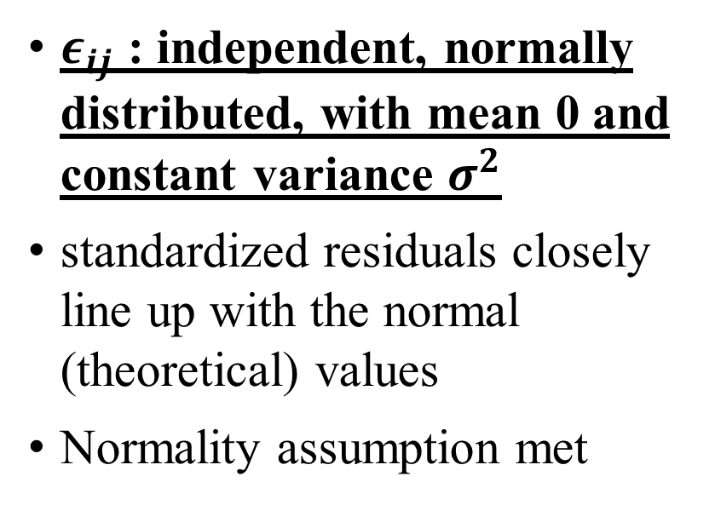
Check Error Assumptions
$ε_{ij}$ : independent, normally distributed, with mean 0 and constant variance $σ^{2}$
standardized residuals closely line up with the normal (theoretical) values
Normality assumption met

Slide 9
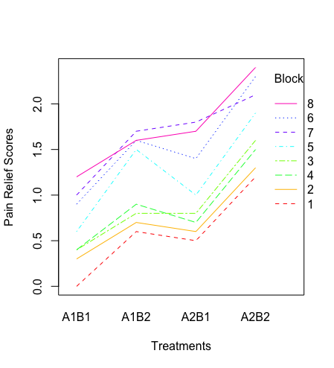
Interaction Block + Treatments
Variations between blocks and treatments
Response lines are closely lined up and share the same trend – unimportant interactions
Three crossings
Are crossings significant and important interactions?
Formal test procedure is needed

Slide 10
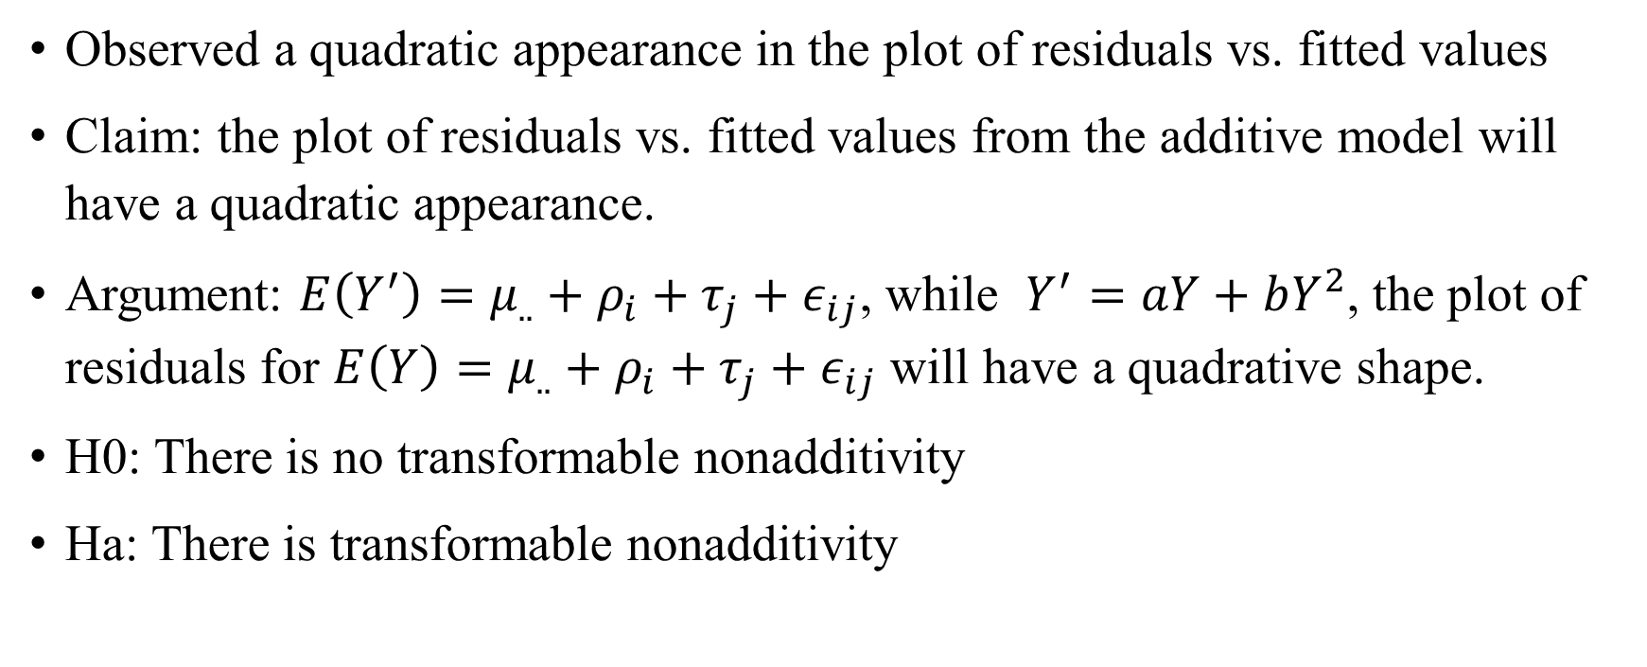
Tukey’s 1 df test
Observed a quadratic appearance in the plot of residuals vs. fitted values
Claim: the plot of residuals vs. fitted values from the additive model will have a quadratic appearance.
Argument: $E\left(Y^{′}\right)=μ_{..}+ρ_{i}+τ_{j}+ε_{ij}$, while $Y^{′}=aY+bY^{2}$, the plot of residuals for $E\left(Y\right)=μ_{..}+ρ_{i}+τ_{j}+ε_{ij}$ will have a quadrative shape.
H0: There is no transformable nonadditivity
Ha: There is transformable nonadditivity

Slide 11
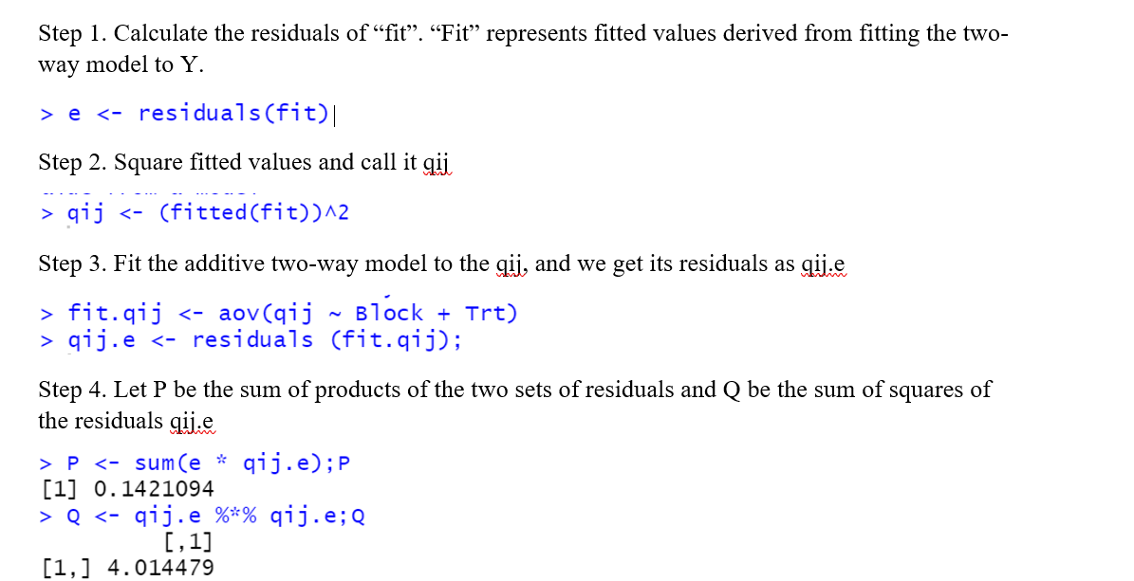
Tukey’s 1 df test

Slide 12
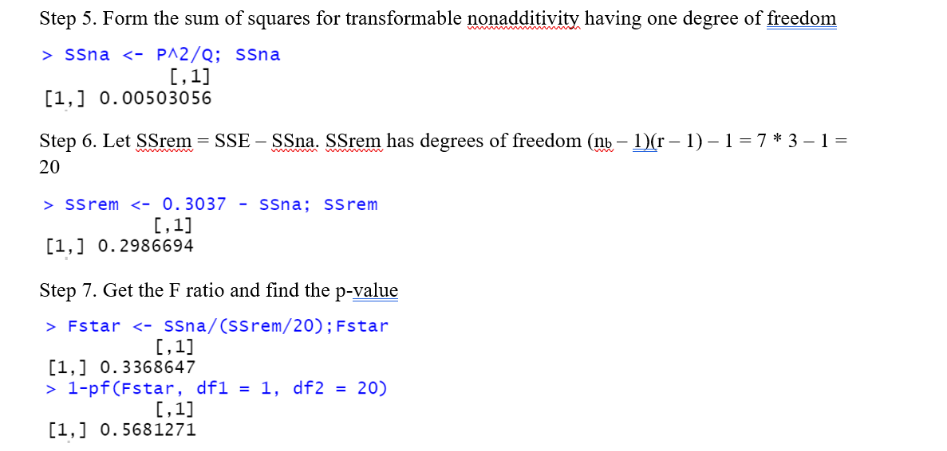
Tukey’s 1 df test

Slide 13
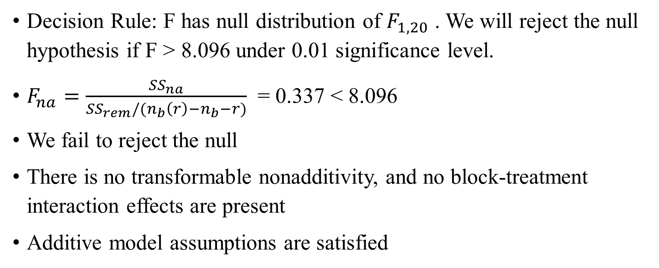
Tukey’s 1 df test
Decision Rule: F has null distribution of $F_{1, 20}$ . We will reject the null hypothesis if F > 8.096 under 0.01 significance level.
$F_{na}=\frac{{SS}_{na}}{{SS}_{rem}/(n_{b}\left(r\right)−n_{b}−r)}$ = 0.337 < 8.096
We fail to reject the null
There is no transformable nonadditivity, and no block-treatment interaction effects are present
Additive model assumptions are satisfied

Slide 14
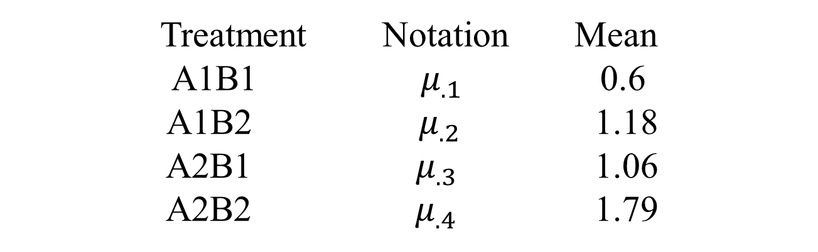
Estimate Contrasts of Treatments
Treatment Notation Mean
A1B1 ${ μ}_{.1}$ 0.6
A1B2 $μ_{.2}$ 1.18
A2B1 ${ μ}_{.3}$ 1.06
A2B2 $μ_{.4}$ 1.79

Slide 15
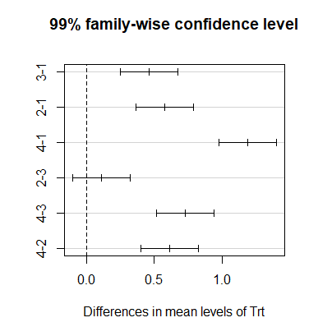

Estimate Contrasts of Treatments
99% confident that all these CIs above contain their respective parameters.
$μ_{.2}−μ_{.3}$ is not statistically significant (A1B2 – A2B1)
There is no significant difference in effects between using Codeine and Acupuncture separately

Slide 16
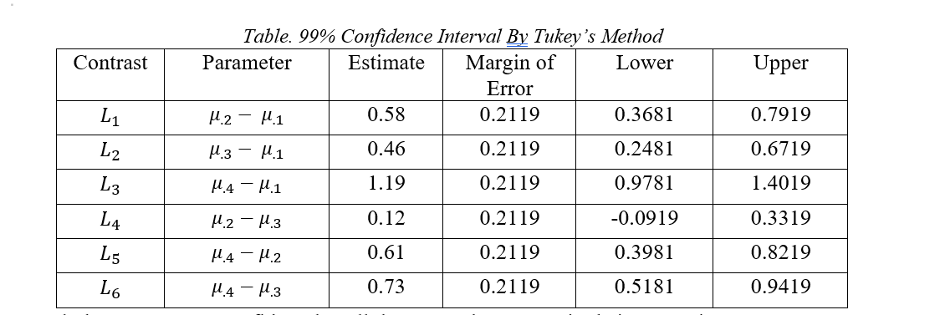
Estimate Contrasts of Treatments

Slide 17

Thank You

